Slide 1

DEEP LEARNING PROJECT
Clean & Dirty Street Image Classification
A MobileNetV2-Based Cleanliness Monitoring System
Your Name | Organization | 2024

Slide 2

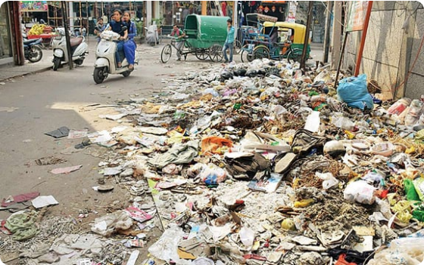
Problem Statement
The Challenge
Manual Monitoring: Current methods are slow, labor-intensive, and inconsistent.
Scalability Issues: Municipal bodies struggle to cover large city areas in real-time.
Objective: Build an automated classifier to instantly label street images as "Clean" or "Dirty".

Slide 3






Project Motivation
Smart City Mission
Efficiency
Automation
Aligns with national initiatives like Swachh Bharat for cleaner, smarter urban living.
Drastically reduces the human effort required for daily city-wide inspections.
Enables integration with CCTVs and mobile apps for 24/7 automated reporting.

Slide 4
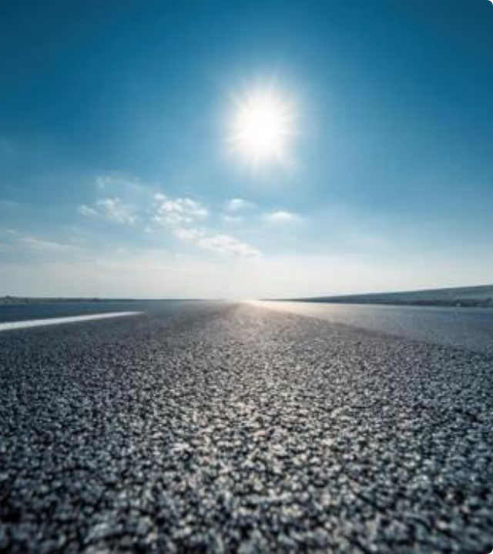
Dataset Overview
Source: Kaggle Road Classification Dataset
Volume: ~1,000+ High-Res Images
Classes:
Clean Roads
Dirty/Littered Roads
Preprocessing:
•
Resized to 224 × 224 pixels
•
Normalized (ImageNet Mean/Std)

Slide 5

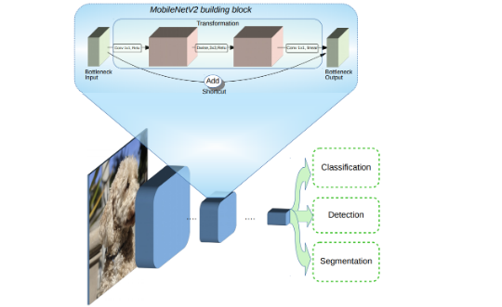

System Architecture: MobileNetV2
Model Pipeline
1.
Input: 224x224 RGB Image
2.
Backbone: MobileNetV2 (Pre-trained on ImageNet)
3.
Feature Extraction: Global Average Pooling
4.
Classification Head: Dense Layer (Softmax)
5.
Output: Probability (Clean vs. Dirty)
Why MobileNetV2? Lightweight and optimized for edge devices like Raspberry Pi.

Slide 6


Training Configuration
Hyperparameters
Environment & Strategy
Optimizer: Adam
Weights: Pre-trained on ImageNet
Learning Rate: 0.0001
Regularization: Early Stopping (Patience=5)
Batch Size: 32
Hardware: NVIDIA GPU (T4/P100)
Epochs: 50
Framework: TensorFlow / PyTorch
Loss Function: CrossEntropyLoss

Slide 7
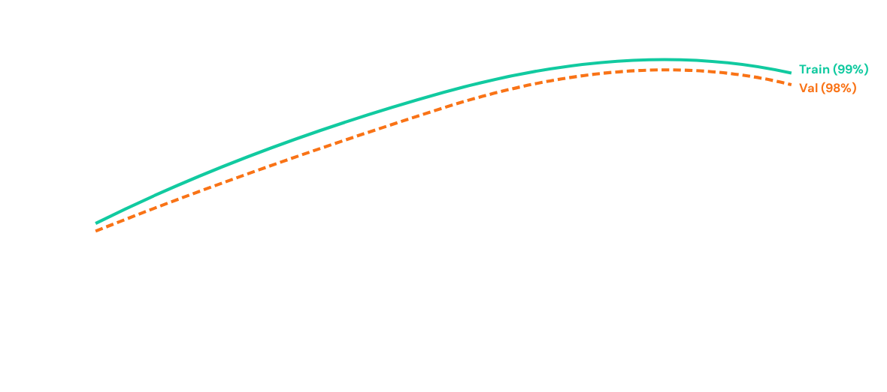
Training Results: Accuracy
Model converged rapidly, reaching stable validation accuracy > 98% with minimal overfitting.

Slide 8
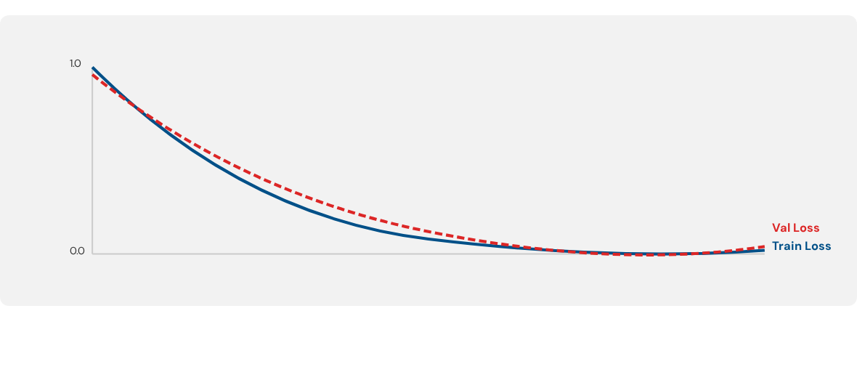
Training Results: Loss Curve
Steady decrease in loss function indicates effective learning without significant divergence.

Slide 9

Confusion Matrix
 | Predicted Clean | Predicted Dirty
Actual Clean | 19 (TP) | 1 (FN)
Actual Dirty | 1 (FP) | 26 (TN)
Total Test Samples: 47 | Errors: 2
High accuracy achieved with minimal misclassification between classes.

Slide 10
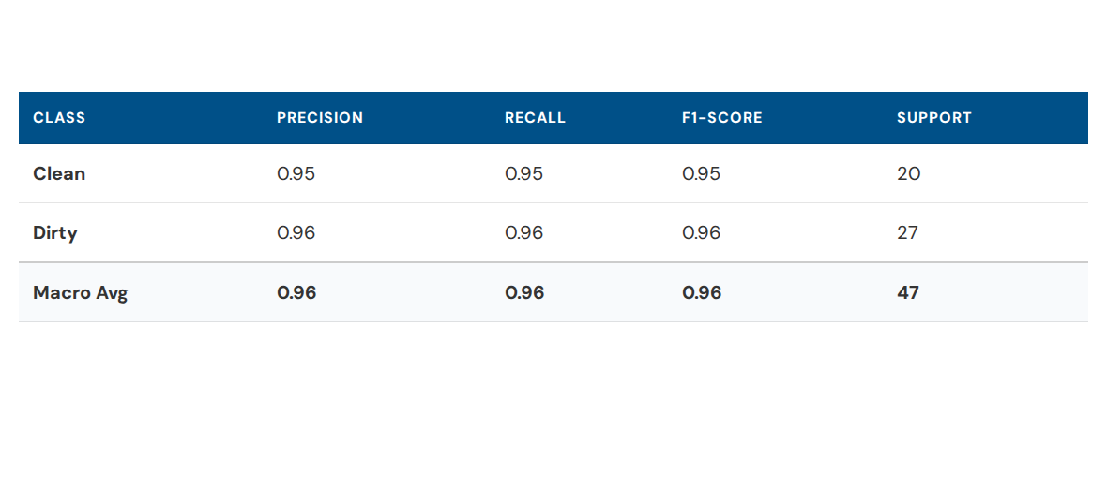
Classification Metrics
Both classes exhibit F1-scores > 0.95, demonstrating that the model is unbiased and robust.

Slide 11

Streamlit Deployment
A user-friendly web interface was built to demonstrate real-time inference.
Image Upload: Simple drag-and-drop interface.
Real-time Inference: Sub-second prediction time.
Confidence Score: Displays probability percentage.
Visual Feedback: Instant "Clean" (Green) or "Dirty" (Red) status.

Slide 12




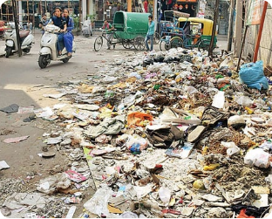
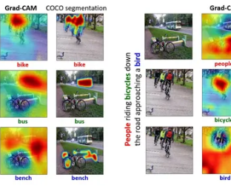
Explainability: Grad-CAM
Insight
The Grad-CAM heatmap highlights the specific regions (garbage piles) that triggered the "Dirty" prediction, confirming the model isn't relying on background noise.
Input Image
Heatmap Overlay

Slide 13
Performance Summary
High Reliability: Consistent performance across diverse lighting conditions.
98%
Fast Inference: MobileNetV2 architecture enables deployment on standard CPUs.
Test Accuracy
Interpretability: Integrated Grad-CAM builds trust in automated auditing.

Slide 14






Limitations
Dataset Size
Conditions
Binary Only
Training data (~1k images) is relatively small, which may limit generalization to unseen cities.
Performance drops in extreme low-light (night) or heavy occlusion scenarios.
Current model implies a strict Clean/Dirty binary, ignoring "Slightly Dirty" nuances.

Slide 15



Future Scope
Multi-class
Edge AI
Live Pipeline
Expand to "Clean", "Littered", "Dump" severity levels.
Deploy on Raspberry Pi/Jetson for decentralized monitoring.
Integrate with city CCTV networks for real-time dashboards.

Slide 16
Conclusion
We successfully built a robust, explainable, and scalable cleanliness classifier. This system serves as a foundational step towards automated, AI-driven Smart City management.

Slide 17
Questions?
Thank you for your attention.
contact@example.com
github.com/your-repo

Slide 18





Image Sources
https://preview.redd.it/c78tqoexllv71.jpg?width=640&crop=smart&auto=webp&s=e27d11b54d81c07a54301f8f7dbc1741545da058
Source: www.reddit.com
https://static.vecteezy.com/system/resources/thumbnails/070/780/646/small/asphalt-road-under-a-sunny-blue-sky-clean-pavement-and-open-horizon-on-a-bright-day-photo.jpeg
Source: www.vecteezy.com
https://1.bp.blogspot.com/-M8UvZJWNW4E/WsKk-tbzp8I/AAAAAAAAChw/OqxBVPbDygMIQWGug4ZnHNDvuyK5FBMcQCLcBGAs/s1600/image5.png
Source: research.google
https://global.discourse-cdn.com/streamlit/optimized/2X/f/f9989b3e116db857aa99dc2b8c52465727663d52_2_690x402.jpeg
Source: discuss.streamlit.io
https://av-eks-lekhak.s3.amazonaws.com/media/__sized__/article_images/Screenshot_198-thumbnail_webp-600x300.webp
Source: www.analyticsvidhya.com

